Slide 1
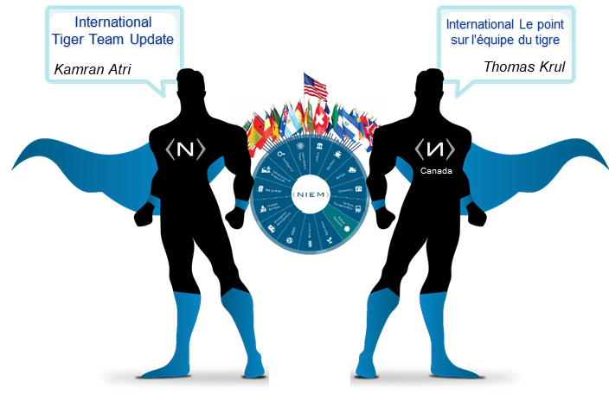
INTERNATIONAL TIGER TEAM
NBAC Face-to-Face Update (2018)
Kamran Atri
NBAC Co-Chair
Thomas Krul
Public Safety Canada
10/29/2018

Slide 2
BACKGROUND
The NBAC International Tiger Team launched in late 2016 with an overarching goal of expanding the utility of NIEM Program to a larger global audience.
2016-2017
Refinements to US-centric terms/definitions in Core
4.0 and 4.1 inputs to both core and domain models
2017 F2F Alignment / NTAC Issue Review
2018-2019
Kick-off May 2018
Initiate translation effort (Canada)
Continued attribute identification (300+ global operations)
Design concepts, governance, and impacts on model architecture and engineering

Slide 3
2018 FOCUS AREAS
Data Model Management – The earliest and still central priority of the tiger team was the review and alignment of both Core and Domain data models with a more International Program focus. This will continue with the identification and review of existing, new or emerging data sets, exchange models, IEPDs or other attribute sources that may yield new, unique attributes that support international exchange.
Translation (Pilot Projects) – Canada’s early translation efforts have kicked off an exciting phase for the NIEM Program that will continue to build upon incremental results. Working with NTAC, the tiger team will seek to develop a step-by-step process roadmap for best practices translation efforts that country users can easily adapt to their own translation requirements
Emerging Priorities – This is a community efforts and we are open to new topics, ideas and project areas that support making NIEM more accessible, useful and connected for the International user community. Topics can be put forth during our recurring meetings or between sessions by directly contacting tiger team co-chairs.

Slide 4
DATA MODEL MANAGEMENT
Data Model Management – The earliest and still central priority of the tiger team was the review and alignment of both Core and Domain data models with a more International Program focus. This will continue with the identification and review of existing, new or emerging data sets, exchange models, IEPDs or other attribute sources that may yield new, unique attributes that support international exchange.
Attribute Identification
Stakeholder Engagement
Future Business Direction
Review, Mapping and Harmonization
Cross Domain Consideration
Alignment with GTRI and release process
Initial 2018 effort has yielded 200-250 new to NIEM attributes with global operational scope. GTRI initial review conducted, packaging underway for formal submission and review and inclusion in NIEM 4.2 release (with International tag)

Slide 5

PRACTICAL APPLICATION :
Nikolay Lipskiy
dgz1@cdc.gov

Slide 6

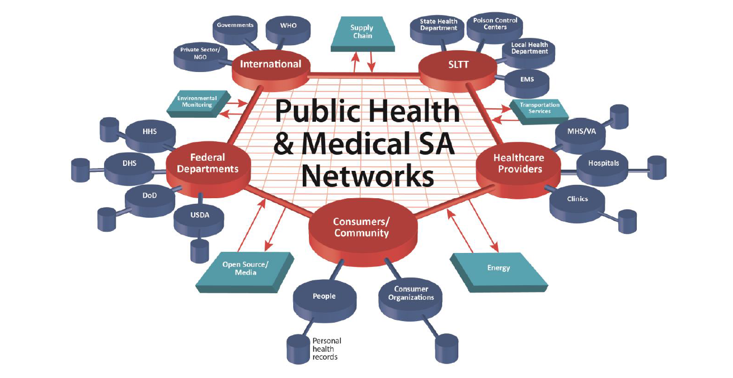
PRACTICAL APPLICATION - CDC
Global Data Model Rationalization and Alignment – CDC PH Emergency Operations Center
USA Centers for Disease Control and Preventions (CDC) is currently working with countries around the globe to help meet the goals of the International Health Regulations (IHR).
CDC’s global programs address over 400 diseases, health threats, and conditions that are major causes of death, disease, and disability.
The CDC Public Health Emergency Operations Center (PH EOC)– a place where highly trained experts monitor information, prepare for known (and unknown) public health events, and gather in the event of an emergency to exchange information and make decisions quickly.
CDC PH EOC collect information from international and national collaborators for developing PH Situational Awareness (SA) and leading PH emergency preparedness operations
In order to act fast and efficient the CDC PH EOC develops tools and solutions for information management that allow to succeed in working with Big Data.
The one of the applied solutions for data management and utilization is development of the PH Emergency Preparedness and Response Common Information Exchange Reference Model (CIERM) and it’s alignment with global and national data models.

Slide 7
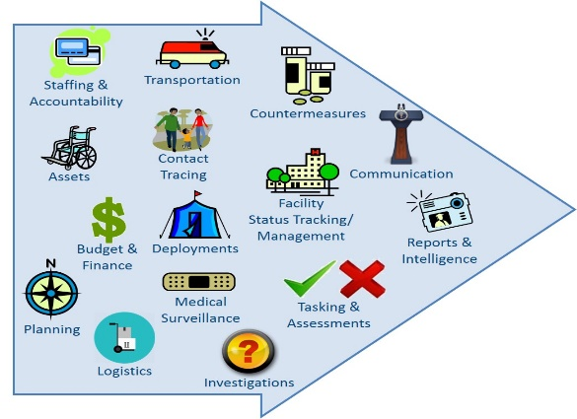
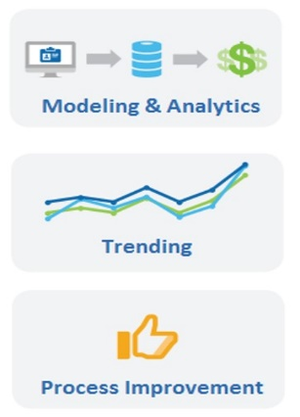

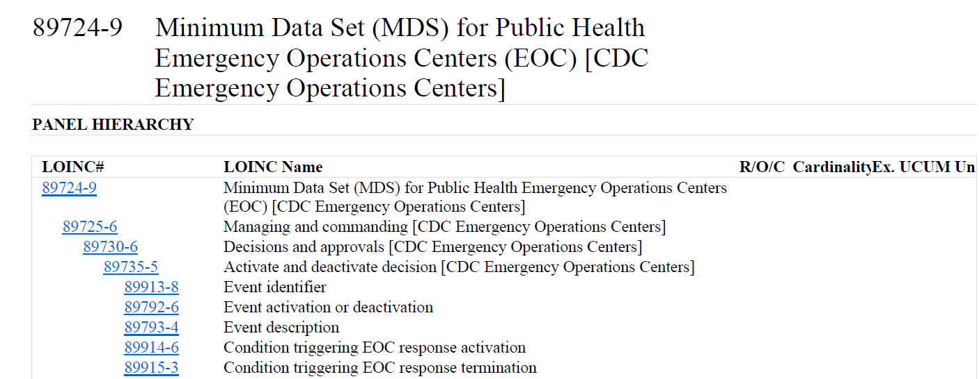
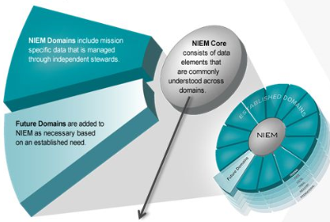
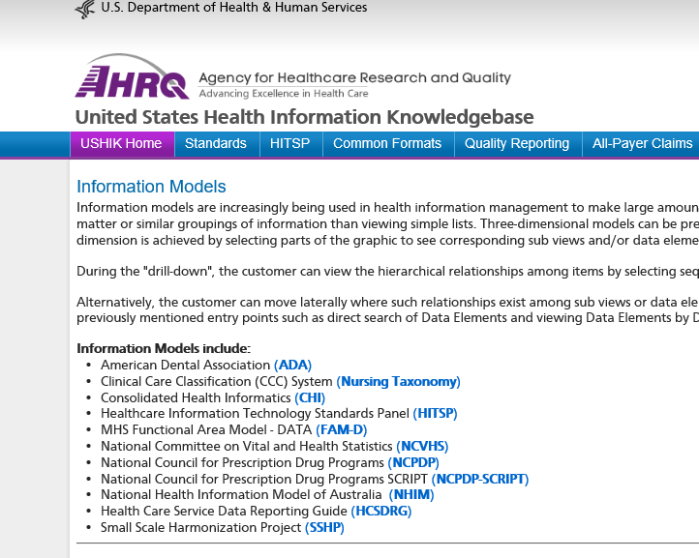
PRACTICAL APPLICATION - CDC
Global Data Model Rationalization and Alignment – CDC PH Emergency Operations Center
The PH Emergency Preparedness and Response Common Information Exchange Reference Model ( PH EPR CIERM) allows to manage a broad scope of information used in PH EOC daily operations
The PH EPR CIERM focused on alignment existing international and national models in a scope PH PRR information domain
Examples of models for alignment
2015 WHO EOC-NET Framework’ model
Logical Observation Identifiers Names and Codes (LOINC) model
NIEM model
And many, many more models…

Slide 8



Public Safety Canada CIOD Interoperability and Portfolio Management SLIDES FOR NIEM F2F
TRANSLATION INITIATIVE :
Thomas Krul
thomas.krul@canada.ca

Slide 9


TRANSLATION INITIATIVE
Translation (Pilot Project) – Canada’s early translation efforts have kicked off an exciting phase for the NIEM Program that will continue to build upon incremental results. Working with NTAC, the tiger team will seek to develop a step-by-step process roadmap for best practices translation efforts that country users can easily adapt to their own translation requirements
Translation Initiative
Document drafted: enumerating all required translation (components, definitions, type of property, etc.).
This will inform costing and effort required.
Subject matter experts have been volunteered/identified – will ensure translated terminology is appropriate and not just a direct translation.
Document drafted: Tracking issues and Best Practices for translation.
NTAC Alignment and Technical Considerations
Other Pilots Possibilities – Japan, Germany

Slide 10
Government of Canada Interoperability Update / Mis à jour
Interoperability and Data Sharing is a key component of Government of Canada’s OneGC Digital Government policy
Communities of Practice, Working Groups, and Tiger Teams working on:
Legislative framework and requirements
Canadian Interoperability challenges
Canadian Interagency Information Exchange goals
NIEM adoption in Canada
The Enterprise Data Community of Practice approaches Interoperability from a technology standpoint (e.g., NIEM, Reference Data Standards, etc.)
The Digital Exchange Community of Practice works on policies, standards, guidelines driving Interoperability for whole of Government
Page 10

Slide 11
Efforts to Internationalize NIEM
Working with the Enterprise Data Community of Practice to make NIEM Government of Canada-wide (standardize use)
Biometrics and Emergency Management domains being extracted via UML modeling tool, translated, evaluated by subject matter experts
Process being documented for best practice(s)
Ongoing discussions regarding use cases and how to best use internationalized versions of NIEM
Page 11

Slide 12
NIEM adoption in Canada (status)
Trusted Information Exchange Services (TIES) wins NIEM award!
Employment and Social Development Canada extensively using NIEM
Other Departments are using or are considering using NIEM as well
NIEM is brought up in practically every Data Sharing / Interoperability / next technologies discussion – word is getting around!
Page 12

Slide 13
Public Safety NIEM Use Cases: Receive
Simplified Receive NIEM Message diagram
Process:
Receive message
Extract message data set
Translate data set to alternate language preference
Marshal information to local information store(s) / systems(s)
If required, reformat data set (alternate language) as a NIEM message using IEPD/XSD
Forward translated message to alternate language users
Page 13

Slide 14
Public Safety NIEM Use Case: Send
Simplified Send NIEM Message diagram
Process:
Pull required information from source system(s)
Format from source system language preference to alternate language
Format information in accordance with the IEPD (XSD)
Initial community preference
Alternate member preference
Issue Language XML/JSON documents to members in language of choice
Page 14

Slide 15
EMERGING PRIORITIES
Emerging Priorities – This is a community efforts and we are open to new topics, ideas and project areas that support making NIEM more accessible, useful and connected for the International user community. Topics can be put forth during our recurring meetings or between sessions by directly contacting tiger team co-chairs.
NTAC Request For Requirements from NBAC Tiger Teams requires engagement with International Tiger Team member and larger communities and stakeholders
TBD – emergent requirements, requests for technical assistance, training or outreach on recurring or ad hoc basis.
LET US KNOW WHAT YOU NEED
NIEM
GUIDANCE
REQUIREMENTS

Slide 16
NBAC INT’L TT 2018 TIMELINE
OCT/NOV
MAY
2018
JUN
2018
JUL
2018
AUG
2018
SEP
2018
OCT
2018
NOV
2018
DEC
2018
JAN
2019
FEB
2018
2018 Kickoff
NIEM 4.1 release
NIEM 4.2 release
Data Model Mngt: 4.1 Alignment / 4.2+ Attribute Identification
C
LEGEND
Tiger Team
Review
C
Translation Pilots (Canada,+)
Deliverable A
NBAC Review
C
Complete /
Release
Emerging Priorities
Deliverable B
C
International Program Level (F2F, Meeting Review)
Ongoing Activities (Outreach and Alignment)
NBAC
5/24
NBAC
6/28
NBAC
7/25
NBAC
8/23
NBAC
9/27
NBAC
10/25
NBAC
11/22
NBAC
1227
NBAC
1/24
NBAC
2/21
2018 Timeline
NBAC F2F
Nov ‘18
Includes Planned Initiatives and TT Review/Release Schedule

Slide 17
INT’L TT NEXT STEPS
Face-to-Face Follow On
Verify Community Requirements
Formalize Deliverables
Roadmap Transitional Efforts
Engagement and Execution
Ensure community alignment with 4.2 Release Planning and Development
Develop NBAC/NTAC guidance on international implementation and development issues
Maintaining primary NIEM tenants (extensibility, scalability, etc.) in all efforts
Developing frameworks, tools and processes to ensure repeatability
Develop sound requirements from International stakeholders

Slide 18
JOIN US
As part of the NIEM International effort, we are all committed to increasing the utility of NIEM for a broad and diverse audience. Identify stakeholders that impact your international exchange requirements and plans and invite them to participate.
Unique Attributes
Existing Data Models & Exchanges
Stakeholders & Exchange Partners
For More Information on NIEM International Tiger Team, please contact the International TT Co-Chairs:
Thomas Krul, Director, Public Safety Canada
thomas.krul@canada.ca
Kamran Atri, Managing Director
NIEM Business Architecture Committee (NBAC) Co-Chair
katri@A4SAFE.COM

